Slide 1
CMOS logic gate concept:
1. Common CMOS logic gates include:
1. Inverter - Uses one pMOS and one nMOS transistor.
2. NAND Gate - Uses two pMOS transistors in parallel and two nMOS transistors in series.
3. NOR Gate - Uses two pMOS transistors in series and two nMOS transistors in parallel.
4. Complex gates like AND, OR, XOR can be constructed using combinations of NAND and NOR gates.
Advantages of CMOS logic:
1.Low power dissipation
2. High noise immunity
3. Wide range of operating voltages
4. Easy to manufacture and scale
CMOS is the most widely used approach for implementing logic functions in modern integrated circuits and computer chips.

Slide 2
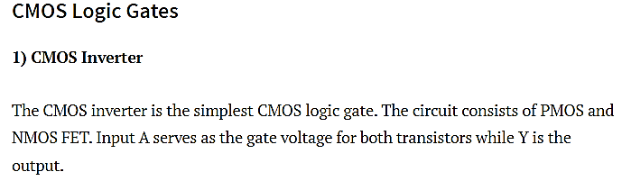
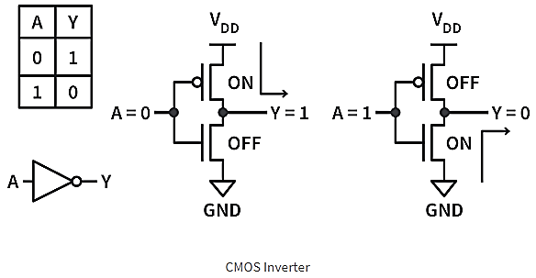

Slide 3
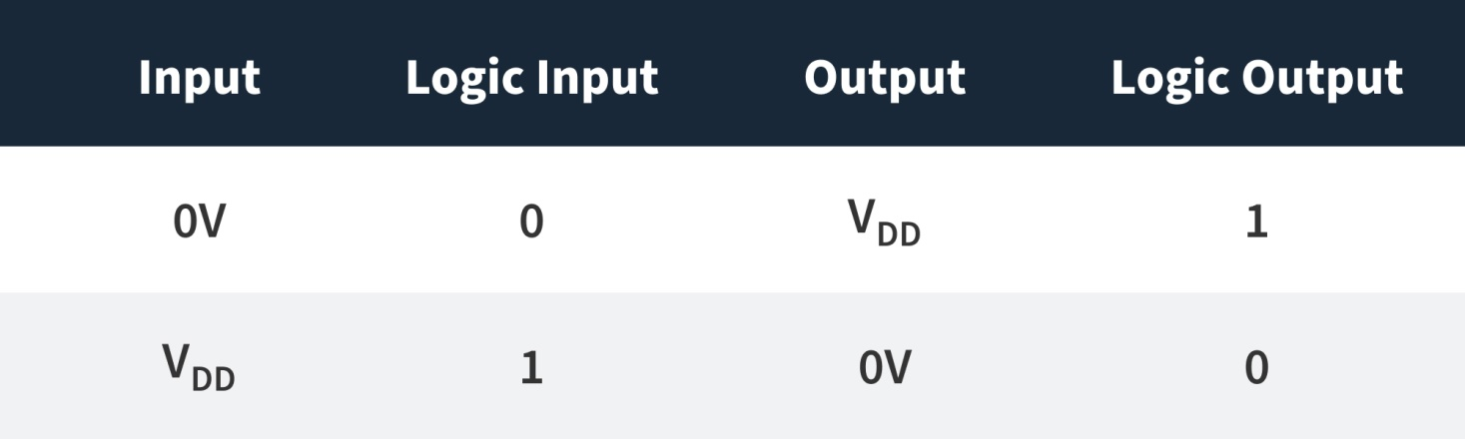
1) CMOS Inverter
The NMOS transistor has an input from V_{SS} or ground and the PMOS transistor has an input from V_{DD}.
When the input (A) is low (<V_{DD}, ~0 V, Logic 0), the NMOS is OFF while the PMOS is ON. V_{DD} will appear at the output through the P-channel MOSFET path.
Hence, there is output (Logic 1) with the circuit pulled up to V_{DD}. When the input is high (~V_{DD}, Logic 1), the PMOS is OFF while the NMOS is ON. The output is pulled down and is therefore low (Logic 0).

Slide 4
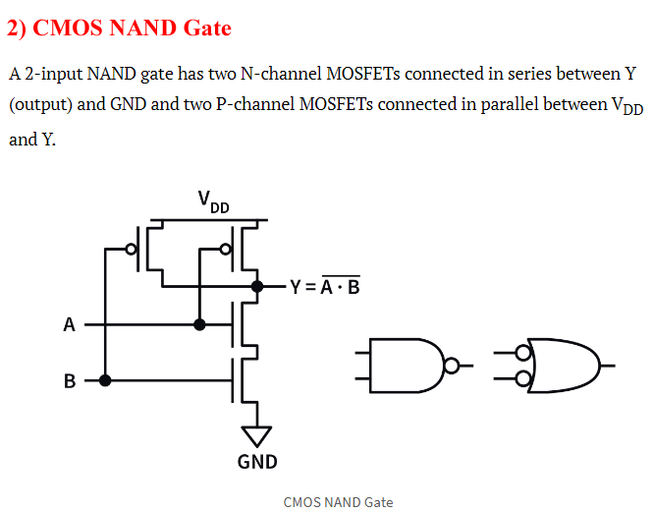
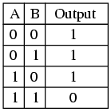

Slide 5
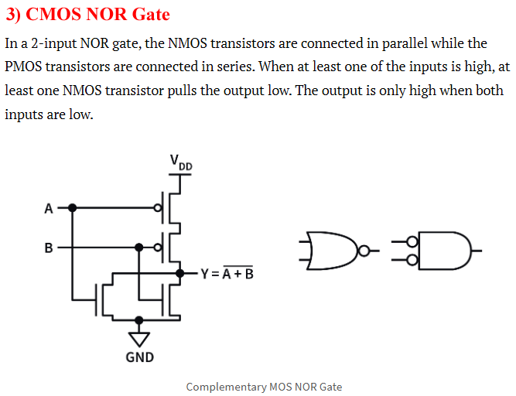

Slide 6
Complex gates in CMOS logic
A complex logic gate is one that implements a function that can provide the basic NOT, AND & OR operations but integrates them into a single circuit.
CMOS is ideally suited for creating gates that have logic equations by exhibiting the following,
1) AND-OR-INVERT - AOI form
2) OR-AND-INVERT - OAI form
An AOI logic equation is equivalent to a complemented SOP from, while an OAI equation is equivalent to a complemented POS structure

Slide 7
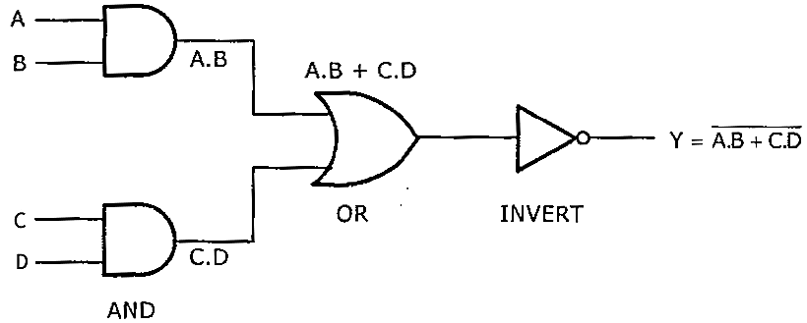
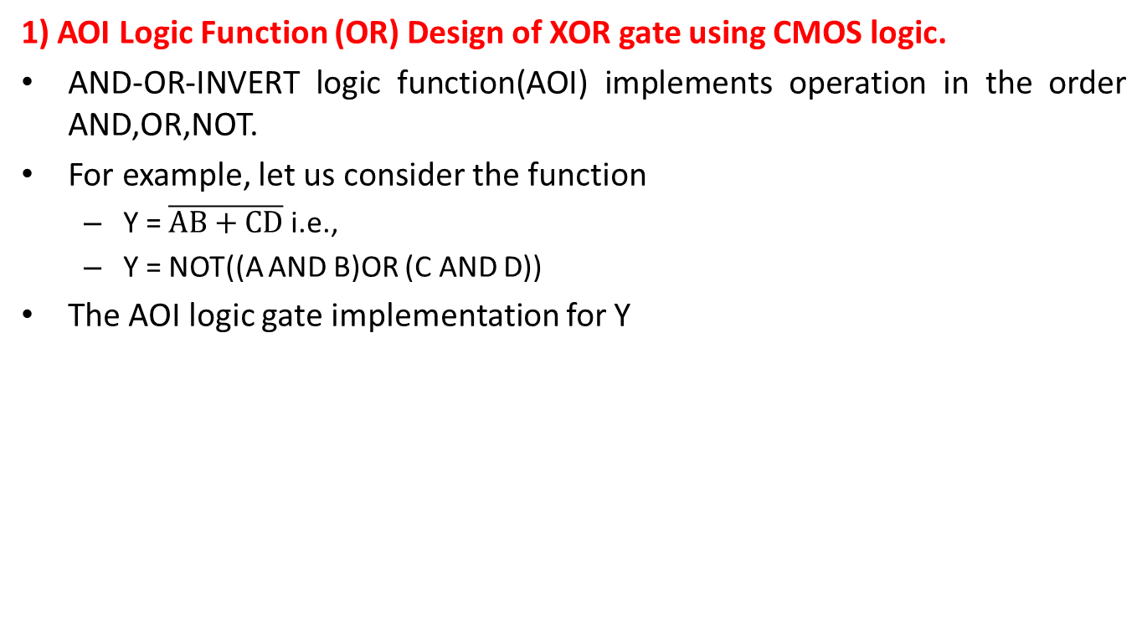
Complex gates in CMOS logic
1) AOI Logic Function (OR) Design of XOR gate using CMOS logic.
AND-OR-INVERT logic function(AOI) implements operation in the order AND,OR,NOT.
For example, let us consider the function
Y = $\overline{AB+CD}$ i.e.,
Y = NOT((A AND B)OR (C AND D))
The AOI logic gate implementation for Y

Slide 8
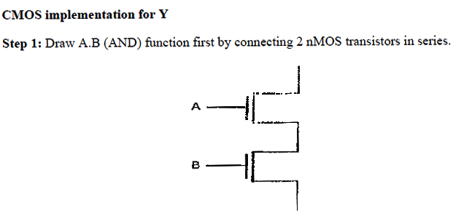
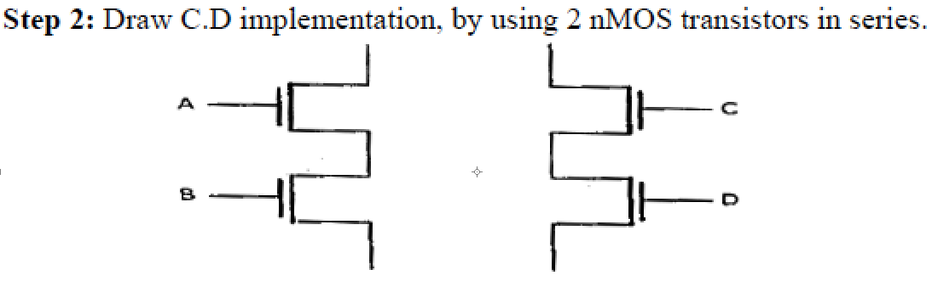
NMOS in Series (AND logic): Equation: y = A AND B =A.B
NMOS in Parallel (OR logic): Equation: y = A OR B =A+B
PMOS in Series (OR logic): Equation: y = A OR B =A+B
PMOS in Parallel (AND logic): Equation: y = A AND B =A.B

Slide 9
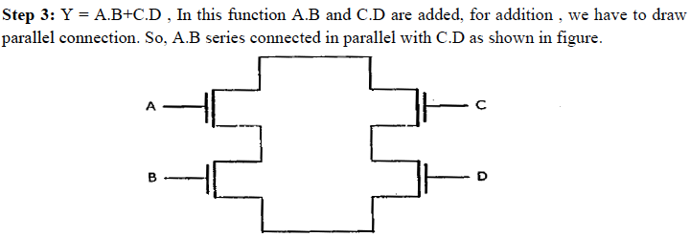

Slide 10
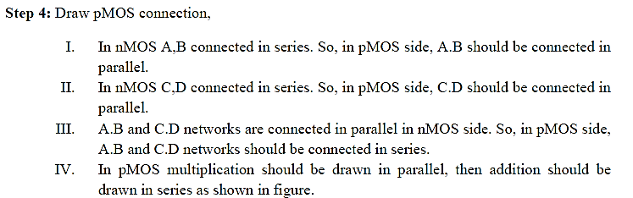
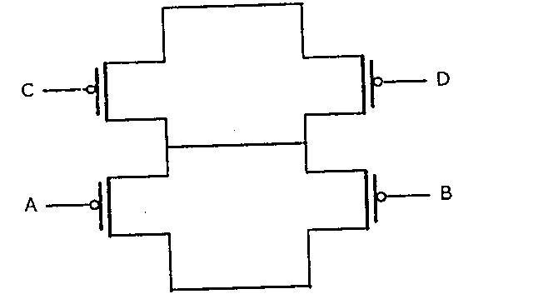

Slide 11
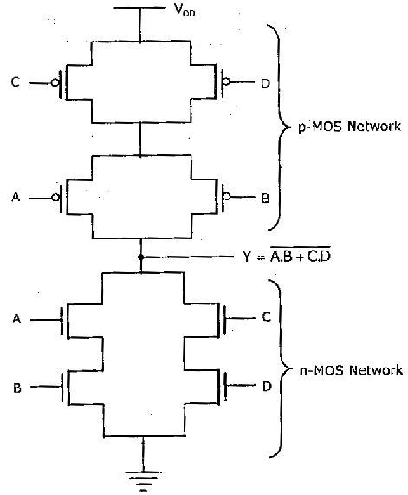
Step 5: Take output at the point in between nMOS and pMOS networks.

Slide 12
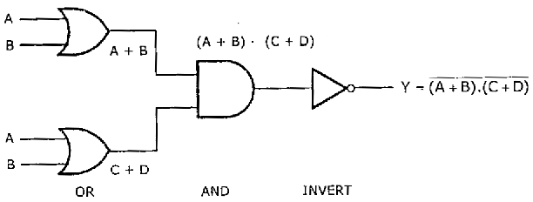

2) OAI Logic Function (OR) Design of XNOR gate using CMOS logic.
OR-AND-INVERT logic function(AOI) implements operation in the order OR,AND,NOT.
For example , let us consider the function
Y = $\overline{\text{(}\text{A}\text{+}\text{B}\text{).(}\text{C}\text{+}\text{D}\text{)}}$ i.e., Y = NOT((A OR B)AND (C OR D))
The OAI logic gate implementation for Y

Slide 13
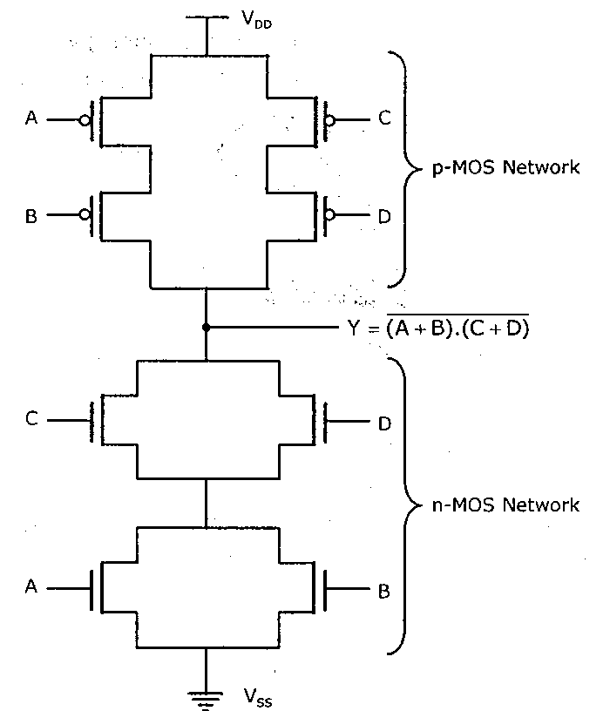
CMOS implementation for Y

